Slide 1
GAME OF TILES
Unix Project

Slide 2
Introduction
The Game of Tiles is a puzzle played on a square, two-dimensional board with numbered tiles that slide.
The goal of this puzzle is to arrange the board’s tiles from smallest to largest, left to right, top to bottom, with an empty space in board’s bottom-right corner.

Slide 3
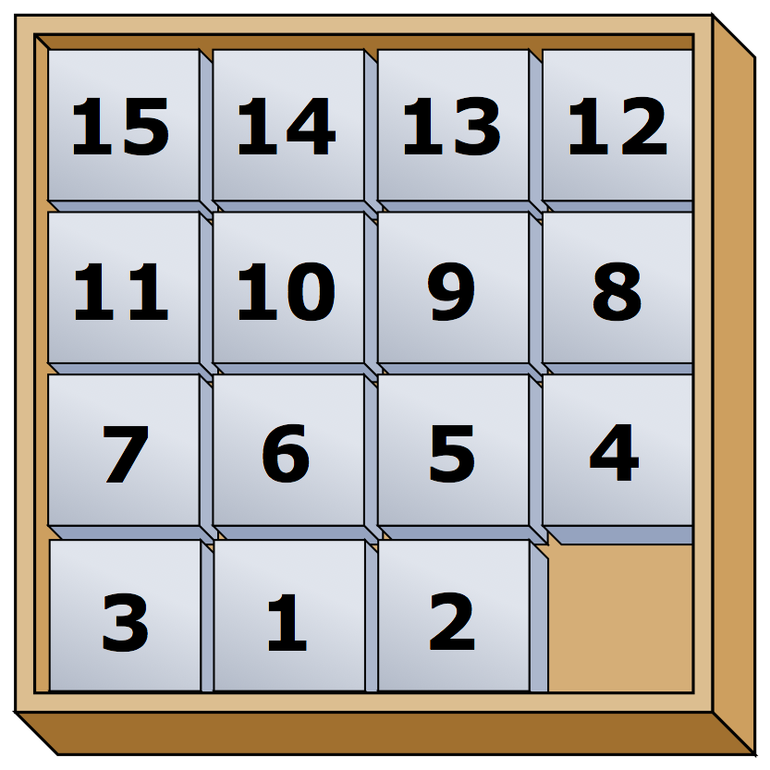
When The Game Starts
All the numbers are arranged in Descending Order.
If the value of n is even the numbers 1 and 2 are swapped otherwise the pattern is unsolvable.

Slide 4
Major Steps Involved In The Game
Implement init
Initializes the Board
Implement draw
Draws the Board
Implement move
Moves the tile
Implement win
Test whether solution is achieved

Slide 5
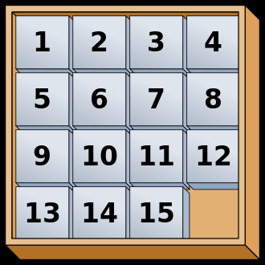
How The Game Ends
When the tiles are arranged in the ascending order as shown in the figure the game ends.
The number of moves and time to complete the game is displayed.
The highest score is also displayed.

Slide 6
AutoComplete Option
The player has an option to autocomplete the game.
The board of 3 or 4 can be completed through autocomplete.

